Slide 1

SELECTING VALUES

Slide 2
SELECTING VALUES FROM VECTORS
Use [ ] brackets to select values from a vector
Can use the following to subset:
Positive integers
Negative integers
Zero
Blank spaces
Logical values
Names

Slide 3
Your turn!
Use the following commands to create a vector of 30 random values.
set.seed(1234)
my_vector <- rnorm(n = 30, mean = 0, sd = 5)
names(my_vector) <- letters

Slide 4
Your turn!
Run each of the following commands. Try to understand how they subset my_vector.
my_vector[]
my_vector[5]
my_vector[3:7]
my_vector[c(1,3,6)]
my_vector[-(2:14)]
my_vector[0]
my_vector[c(TRUE, FALSE, TRUE, FALSE, FALSE)]
my_vector[c("b", "n", "r")]

Slide 5
Solution
# select every element of my_vector
my_vector[]
a b c d e
-6.0353287 1.3871462 5.4222059 -11.7284885 2.1456234
f g h i j
2.5302795 -2.8736998 -2.7331593 -2.8222600 -4.4501891
k l m n o
-2.3859635 -4.9919322 -3.8812695 0.3222941 4.7974703
p q r s t
-0.5514275 -2.5550475 -4.5559771 -4.1858584 12.0791759
u v w x y
0.6704411 -2.4534295 -2.2027394 2.2979472 -3.4686012
z <NA> <NA> <NA> <NA>
-7.2410246 2.8737786 -5.1182786 -0.0756915 -4.6797430

Slide 6
Solution
# select the fifth element of my_vector
my_vector[5]
e
2.145623

Slide 7
Solution
# select the 3rd through 7th elements of my_vector
my_vector[3:7]
c d e f g
5.422206 -11.728489 2.145623 2.530279 -2.873700

Slide 8
Solution
# select the 1st, 3rd, and 6th elements of my_vector
my_vector[c(1,3,6)]
a c f
-6.035329 5.422206 2.530279

Slide 9
Solution
# select every element of my_vector EXCEPT the 2nd through 14th elements
my_vector[-(2:14)]
a o p q r s
-6.0353287 4.7974703 -0.5514275 -2.5550475 -4.5559771 -4.1858584
t u v w x y
12.0791759 0.6704411 -2.4534295 -2.2027394 2.2979472 -3.4686012
z <NA> <NA> <NA> <NA>
-7.2410246 2.8737786 -5.1182786 -0.0756915 -4.6797430

Slide 10
Solution
# returns an empty object
# this isn’t very useful
my_vector[0]
named numeric(0)

Slide 11
Solution
# returns the 1st element, excludes the 2nd element, returns the 3rd element
# excludes the 4th and 5th elements
# repeat this pattern through the entire vector
my_vector[c(TRUE, FALSE, TRUE, FALSE, FALSE)]
a c f h k m
-6.0353287 5.4222059 2.5302795 -2.7331593 -2.3859635 -3.8812695
p r u w z <NA>
-0.5514275 -4.5559771 0.6704411 -2.2027394 -7.2410246 -5.1182786

Slide 12
Solution
# select the elements named b, n, and r of my_vector
# can only do this when elements have names
my_vector[c("b", "n", "r")]
a c f
-6.035329 5.422206 2.530279

Slide 13
Your turn!
Look at documentation for the WorldPhones data set in R (R has many built-in data sets to make learning easy and fun). Acquaint yourself by using some commands we’ve learned today (e.g., str()).
Using the hint that the command WorldPhones[ , ] will return all rows and columns of the data frame and your knowledge of subsetting vectors, extract the following:

Slide 14
Your turn!
The 1st row and all columns from WorldPhones
The 2nd, 3rd, and 6th rows; the 2nd through 5th columns
All rows; repeat the 3rd column twice
All rows; every column except the 1st and 7th
An empty data frame (think an empty object)
The penultimate row by using a function and not the number 6; all columns

Slide 15
Solution
# The 1st row and all columns from WorldPhones
WorldPhones[1, ]
N.Amer Europe Asia S.Amer Oceania Africa Mid.Amer
45939 21574 2876 1815 1646 89 555

Slide 16
Solution
# The 2nd, 3rd, and 6th rows; the 2nd through 5th columns
WorldPhones[c(2, 3, 6), c(2, 5)]
Europe Oceania
1956 29990 2366
1957 32510 2526
1960 40341 3054

Slide 17
Solution
# All rows; repeat the 3rd column twice
WorldPhones[, c(3, 3)]
Asia Asia
1951 2876 2876
1956 4708 4708
1957 5230 5230
1958 6662 6662
1959 6856 6856
1960 8220 8220
1961 9053 9053

Slide 18
Solution
# All rows; every column except the 1st and 7th
WorldPhones[, -c(1, 7)]
Europe Asia S.Amer Oceania Africa
1951 21574 2876 1815 1646 89
1956 29990 4708 2568 2366 1411
1957 32510 5230 2695 2526 1546
1958 35218 6662 2845 2691 1663
1959 37598 6856 3000 2868 1769
1960 40341 8220 3145 3054 1905
1961 43173 9053 3338 3224 2005

Slide 19
Solution
# An empty object (think an empty object)
WorldPhones[0, 0]
<0 x 0 matrix>

Slide 20
Solution
# The penultimate row by using a command and not the number 6; all columns
WorldPhones[nrow(WorldPhones) - 1, ]
N.Amer Europe Asia S.Amer Oceania Africa Mid.Amer
76036 40341 8220 3145 3054 1905 1008

Slide 21
SELECTING COLUMNS FROM DATA FRAMES
Able to use data_frame[ , ] notation to select rows/columns from a data frame
We’ll learn the dplyr package later to select rows/columns quickly and efficiently
Base R way to select columns: $, [ ], and [[ ]]

Slide 22
SELECTING COLUMNS FROM DATA FRAMES
Preserve the structure of the output to be the same as the input with data_frame[column]
Can use a column name in quotes or a column index
Simplify the structure of the output with data_frame[[column]]
Can use a column name in quotes or a column index
Simplify the structure of the output to be a smaller structure than the input with data_frame$column
Must use a column name with a $

Slide 23
SELECTING COLUMNS FROM DATA FRAMES
Preserve with data_frame[column]
# Preserve structure, use a column name
# The input mtcars is a data frame
# and the output is also a data frame
mtcars["disp"]
disp
Mazda RX4 160.0
Mazda RX4 Wag 160.0
Datsun 710 108.0
Hornet 4 Drive 258.0
Hornet Sportabout 360.0
Valiant 225.0
Duster 360 360.0
Merc 240D 146.7
Merc 230 140.8
Merc 280 167.6
Merc 280C 167.6
Merc 450SE 275.8
# Preserve structure, use a column index
mtcars[3]
disp
Mazda RX4 160.0
Mazda RX4 Wag 160.0
Datsun 710 108.0
Hornet 4 Drive 258.0
Hornet Sportabout 360.0
Valiant 225.0
Duster 360 360.0
Merc 240D 146.7
Merc 230 140.8
Merc 280 167.6
Merc 280C 167.6
Merc 450SE 275.8

Slide 24
SELECTING COLUMNS FROM DATA FRAMES
Simplify with data_frame[[column]]
# Simplify structure, use a column name
# Notice the structure of the output is now a vector and NOT a data frame
mtcars[["disp"]]
[1] 160.0 160.0 108.0 258.0 360.0
[6] 225.0 360.0 146.7 140.8 167.6
[11] 167.6 275.8 275.8 275.8 472.0
[16] 460.0 440.0 78.7 75.7 71.1
[21] 120.1 318.0 304.0 350.0 400.0
[26] 79.0 120.3 95.1 351.0 145.0
[31] 301.0 121.0
# Simplify structure, use a column index
mtcars[[3]]
[1] 160.0 160.0 108.0 258.0 360.0
[6] 225.0 360.0 146.7 140.8 167.6
[11] 167.6 275.8 275.8 275.8 472.0
[16] 460.0 440.0 78.7 75.7 71.1
[21] 120.1 318.0 304.0 350.0 400.0
[26] 79.0 120.3 95.1 351.0 145.0
[31] 301.0 121.0

Slide 25
SELECTING COLUMNS FROM DATA FRAMES
Simplify with data_frame$column
# Simplify structure, use a column name
# Notice the structure of the output is now a vector and NOT a data frame
mtcars$disp
[1] 160.0 160.0 108.0 258.0 360.0
[6] 225.0 360.0 146.7 140.8 167.6
[11] 167.6 275.8 275.8 275.8 472.0
[16] 460.0 440.0 78.7 75.7 71.1
[21] 120.1 318.0 304.0 350.0 400.0
[26] 79.0 120.3 95.1 351.0 145.0
[31] 301.0 121.0
# Simplify structure, use a column index
# MUST use a column name with $
mtcars$3
Error: unexpected numeric constant in "mtcars$3"

Slide 26
SELECTING VALUES FROM LISTS
Use $, [ ], and [[ ]] to select items and values from lists
Sometimes need combinations of $, [ ], and [[ ]] to extract desired information
Let’s practice!

Slide 27
Your turn!
Run the command model <- lm(mpg ~ ., data = mtcars).
Run the command str(model) to examine your model.
What do the following commands do? What structures should you expect?
model["fitted.values"]
model$coefficients[["wt"]]
model[["residuals"]][1:10]

Slide 28
Solution
# Linear model, mpg as a function of every other variable in the mtcars data set
model <- lm(mpg ~ ., data = mtcars)
# look at structure of model
str(model)
List of 12
$ coefficients : Named num [1:11] 12.3034 -0.1114 0.0133 -0.0215 0.7871 ...
..- attr(*, "names")= chr [1:11] "(Intercept)" "cyl" "disp" "hp" ...
$ residuals : Named num [1:32] -1.6 -1.112 -3.451 0.163 1.007 ...
..- attr(*, "names")= chr [1:32] "Mazda RX4" "Mazda RX4 Wag" "Datsun 710" "Hornet 4 Drive" ...
$ effects : Named num [1:32] -113.65 -28.6 6.13 -3.06 -4.06 ...
..- attr(*, "names")= chr [1:32] "(Intercept)" "cyl" "disp" "hp" ...
$ rank : int 11
$ fitted.values: Named num [1:32] 22.6 22.1 26.3 21.2 17.7 ...
..- attr(*, "names")= chr [1:32] "Mazda RX4" "Mazda RX4 Wag" "Datsun 710" "Hornet 4 Drive" ...
$ assign : int [1:11] 0 1 2 3 4 5 6 7 8 9 ...

Slide 29
Solution
# Look at the fitted values of the linear model
# Output structure is a list
model["fitted.values"]
Mazda RX4 Mazda RX4 Wag Datsun 710
22.59951 22.11189 26.25064
Hornet 4 Drive Hornet Sportabout Valiant
21.23740 17.69343 20.38304
Duster 360 Merc 240D Merc 230
14.38626 22.49601 24.41909
# look at class of output
class(model["fitted.values"])
[1] "list"

Slide 30
Solution
# Look at the weight coefficient
model$coefficients[["wt"]]
[1] -3.715304
# look at class of output
# Output structure is a numeric vector
class(model$coefficients[["wt"]])
[1] "numeric"

Slide 31
Solution
# Look at the weight coefficient
model[["residuals"]][1:10]
Mazda RX4 Mazda RX4 Wag Datsun 710 Hornet 4 Drive
-1.59950576 -1.11188608 -3.45064408 0.16259545
Hornet Sportabout Valiant Duster 360 Merc 240D
1.00656597 -2.28303904 -0.08625625 1.90398812
Merc 230 Merc 280
-1.61908990 0.50097006
# look at class of output
# Output structure is a numeric vector
typeof(model[["residuals"]][1:10])
[1] "double"

Slide 32

MODIFYING VALUES

Slide 33
MODIFYING VECTOR VALUES
Describe the value(s) you want to modify
Then use the <- assignment operator to overwrite the value(s) you described!
Modifying elements overwrites; it doesn’t create a new copy! Watch out!
# Make a lame dumb example vector
lame_dumb_vector <- c(1, 2, 3, 4, 5)
# Overwrite the first value with 8675309
lame_dumb_vector[1] <- 8675309
# QA every day! Check the vector!
lame_dumb_vector
[1] 8675309 2 3 4 5

Slide 34
MODIFYING MANY VECTOR VALUES
Can change multiple values at once
Can use vector recycling to your advantage
# Make a lame dumb example vector
lame_dumb_vector <- c(1, 2, 3, 4, 5)
# Overwrite the 1st and 3rd values with 867 and 5309
lame_dumb_vector[c(1, 3)] <- c(867, 5309)
# Overwrite the other values with -1
lame_dumb_vector[c(2, 4, 5)] <- -1
# QA every day! Check the vector!
lame_dumb_vector
[1] 867 -1 5309 -1 -1

Slide 35
MODIFYING DATA FRAME VALUES
To modify data frame values:
Select a column
Subset for the elements you want to modify
Assign a vector of values to replace them!
# save a copy of the iris data frame
iris_df <- iris
# select the Sepal.Length column
# then change the first 3 values in that column
iris_df$Sepal.Length[1:3] <- 1000
# QA every day
# check the data frame
head(iris_df)
Sepal.Length Sepal.Width Petal.Length Petal.Width Species
1 1000.0 3.5 1.4 0.2 setosa
2 1000.0 3.0 1.4 0.2 setosa
3 1000.0 3.2 1.3 0.2 setosa
4 4.6 3.1 1.5 0.2 setosa
5 5.0 3.6 1.4 0.2 setosa
6 5.4 3.9 1.7 0.4 setosa

Slide 36
MODIFYING VECTORS WITH LOGIC
Logical operators return TRUE or FALSE for element-wise comparisons
1 != 2
TRUE
3 > c(5, 1, 3)
FALSE TRUE FALSE
c(5, 1, 3) == c(3, 1, 5)
FALSE TRUE FALSE
1 %in% c(5, 1, 3)
TRUE
c(19, 3) %in% c(5, 1, 3)
FALSE TRUE
c(1, 8, 0, 9) %in% c(5, 1, 3)
TRUE FALSE FALSE FALSE
Operator | Syntax
> | a > b
>= | a >= b
< | a< b
<= | a <= b
== (check for equality) | a == b
!= (check for not equal) | a != b
%in% (check for group membership) | a %in% c(a, b, c)

Slide 37
MODIFYING VECTORS WITH LOGIC
We can leverage logical comparisons to modify values in vectors
Think through what each command outputs and how logical comparisons select which elements to modify!
No, you don’t need all three steps every time you want to logically subset. Thank heavens.
# save a copy of the iris data frame
iris_df <- iris
# TRUE/FALSE Boolean values for
# if Petal.Width is greater than 1
iris_df$Petal.Width > 1
# only observations with Petal.Width > 1
# show Petal.Width column
iris_df$Petal.Width[iris_df$Petal.Width > 1]
# change all Petal.Width > 1 values to -3
iris_df$Petal.Width[iris_df$Petal.Width > 1] <- -3

Slide 38
SUBSET THEN SELECT DF COLUMNS
Use logical comparisons to filter for certain observations and then select all columns from a data frame
Combine logical comparisons with & or | (and or…..or)
# filter for observations with a Sepal.Length
# greater than 7.3
# and show all columns for those observations
iris[iris$Sepal.Length > 7.3, ]
# filter for observations with:
# 1) Sepal.Length greater than 7.3, AND
# 2) Petal.Length greater than 6.3
iris[iris$Sepal.Length > 7.3 & iris$Petal.Length > 6.3, ]
# filter for observations with:
# 1) Sepal.Length greater than 7.3, OR
# 2) Petal.Width < 1.8
iris[iris$Sepal.Length > 7.3 | iris$Petal.Width < 1.8, ]

Slide 39
Your turn!
Read documentation for the esoph built-in R data set.
Filter the esoph data set for observations (showing all columns) with:
Tobacco consumptions either 0-9 grams per day or 10-19 grams per day, AND
Number of cases greater than zero

Slide 40
Solution
# Documentation
?esoph
# pull information
esoph[esoph$tobgp %in% c("0-9g/day", "10-19") & esoph$ncases > 0, ]
agegp alcgp tobgp ncases ncontrols
13 25-34 120+ 10-19 1 1
17 35-44 0-39g/day 10-19 1 14
21 35-44 40-79 10-19 3 23
28 35-44 120+ 0-9g/day 2 3
31 45-54 0-39g/day 0-9g/day 1 46
35 45-54 40-79 0-9g/day 6 38

Slide 41

MISSING DATA

Slide 42
MISSING VALUES IN R
R shows missing values as NA
Missing values prevent R from calculating sums, means, equality checks, etc.
Use the is.na() function to check for missing values—this function is another logical operator in R
# adding missing values to numbers results in NA
8 + NA
[1] NA
# missing values mess up means
mean(c(1, 2, 3, NA, 5))
[1] NA
# this is why we use the na.rm = TRUE argument!
mean(c(1, 2, 3, NA, 5), na.rm = TRUE)
[1] 2.75

Slide 43
COUNTING MISSING VALUES
Use the is.na() function to check for missing values—this function is another logical operator in R
Use sum(is.na()) to calculate the total number of missing values
Use colSums(is.na()) to calculate the number of missing values per column
# example data frame
df <- data.frame(col1 = c(1:3, NA),
col2 = c("this", NA,"is", "text"),
col3 = c(TRUE, FALSE, TRUE, TRUE),
col4 = c(2.5, NA, NA, NA),
stringsAsFactors = FALSE)
# illustrate is.na() function
is.na(df)
col1 col2 col3 col4
[1,] FALSE FALSE FALSE FALSE
[2,] FALSE TRUE FALSE TRUE
[3,] FALSE FALSE FALSE TRUE
[4,] TRUE FALSE FALSE TRUE
# count missing values
sum(is.na(df))
[1] 5
colSums(is.na(df))
col1 col2 col3 col4
1 1 0 3

Slide 44
REMOVING INCOMPLETE OBSERVATIONS
Use complete.cases() to keep only observations with no missing values
Can also use na.omit() to remove incomplete observations
Discuss with stakeholders/clients before simply removing observations! Maybe missing data exists for a reason!
# complete cases
complete.cases(df)
[1] TRUE FALSE FALSE FALSE
# subset with complete observations only
df[complete.cases(df), ]
col1 col2 col3 col4
col1 col2 col3 col4
1 this TRUE 2.5
# or subset with `!` operator to retrieve incomplete cases
df[!complete.cases(df), ]
[1] 5
col1 col2 col3 col4
2 2 <NA> FALSE NA
3 3 is TRUE NA
4 NA text TRUE NA
# can also use na.omit() to subset for complete obs. Only
na.omit(df)
col1 col2 col3 col4
1 1 this TRUE 2.5

Slide 45
Your turn!
How many missing values are in the built-in data set airquality?
Which variables are the missing values concentrated in?
How would you impute the mean or median for these values?
How would you omit all rows containing missing values?

Slide 46
Solution
# 1) how many missing values?
# number of missing values
sum(is.na(airquality))
[1] 44
# 2) which variables have missing values
# number of missing values by variable
colSums(is.na(airquality))
Ozone Solar.R Wind Temp Month Day
37 7 0 0 0 0

Slide 47
Solution
# let’s save a copy of the data set, first
airquality_copy <- airquality
# 3) how to impute the mean/median
# imputing, for example, the mean for the Ozone variable
airquality_copy$Ozone[is.na(airquality_copy$Ozone)] <- mean(airquality_copy$Ozone, na.rm = TRUE)
# number of missing values by variable
colSums(is.na(airquality_copy))
Ozone Solar.R Wind Temp Month Day
0 7 0 0 0 0

Slide 48
Solution
# 4) keep complete cases only
# use any of the following functions
airquality_complete <- complete.cases(airquality)
OR
airquality_complete <- na.omit(airquality)
# QA every day!
sum(is.na(airquality_complete))
[1] 0

Slide 49

get to know data

Slide 50
learn about the data
For quick data exploration, base R plotting functions can provide an expeditious and straightforward approach to understanding your data.
What are some functions to extract this information?

Slide 51
quick plots
Function | Description
? | scatter plot
? | line chart
? | bar chart
? | histogram
? | box plot
? | stem & leaf plot

Slide 52
quick plots
Function | Description
plot(x, y) | scatter plot
plot(x, y, type = “l”) | line chart
barplot(table(x)) | bar chart
hist(x) | histogram
boxplot(y ~ x, data) | box plot
stem(x) | stem & leaf plot

Slide 53
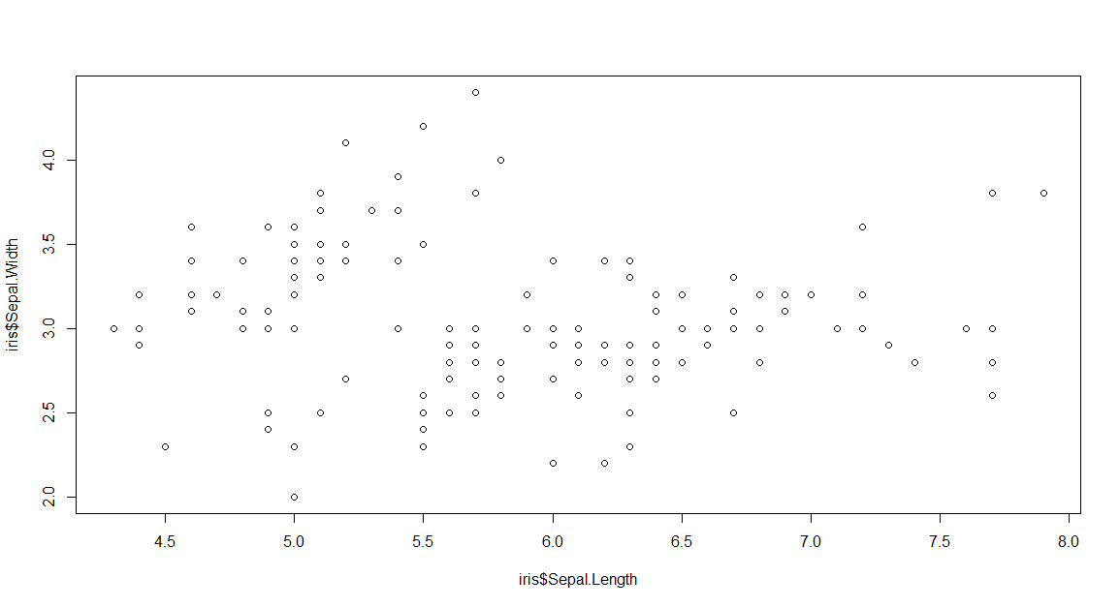
EXAMPLES OF BASE R PLOTS
The plot() function is very good at guessing what plot you want or should have
Some base R plotting functions let you specify the data set without using $ to select variables for each argument
Base R plots may not be pretty but they’re quick to make!
Don’t worry! We’ll learn the ggplot2 package for data visualization soon.
# super quick scatterplot with the (groan) iris data
plot(iris$Sepal.Length, iris$Sepal.Width)

Slide 54
Your turn!
Use the chickwts data set to make the following visualizations.
Boxplots of the weight variable by feed. Look at documentation for the data set and for the boxplot() function if needed.
A table of the feed variable. Use the $ symbol to select the feed variable here.
A histogram of the weight variable.

Slide 55
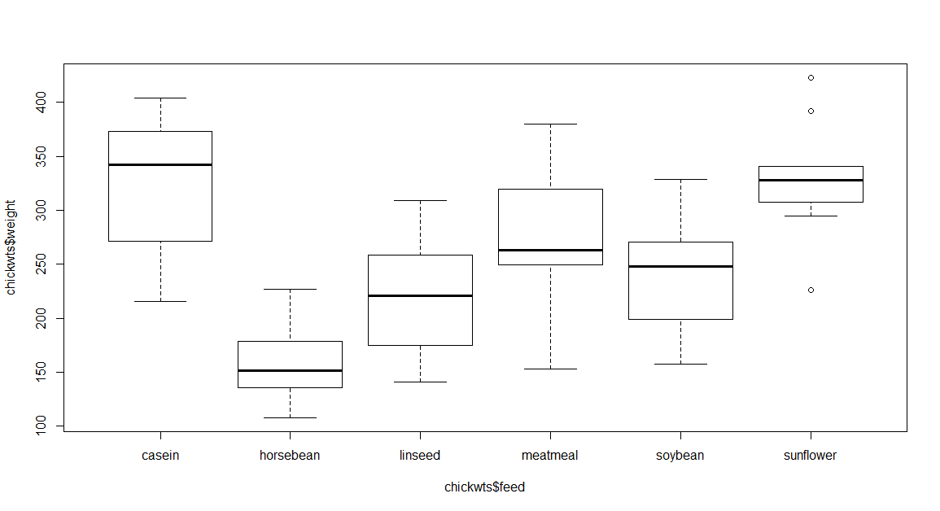
Solution
# 1) boxplots
# use either command below
# both produce the same boxplots
boxplot(weight ~ feed, data = chickwts)
boxplot(chickwts$weight ~ chickwts$feed)

Slide 56
Solution
# 2) table of the feed variable
table(chickwts$feed)
casein horsebean linseed meatmeal soybean sunflower
12 10 12 11 14 12

Slide 57
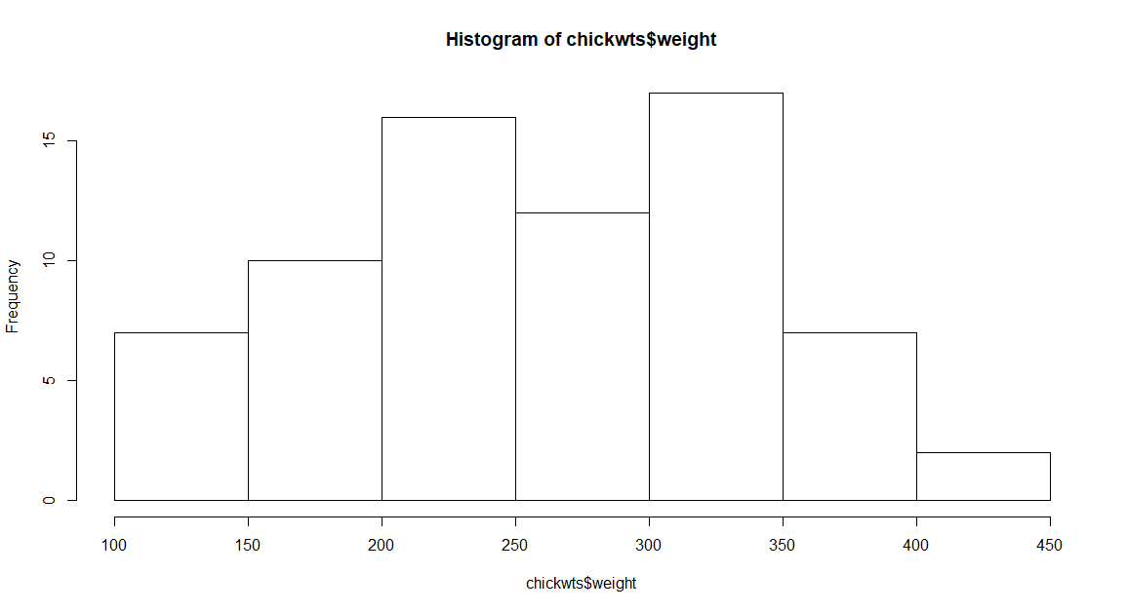
Solution
# 3) histogram of the weight variable
hist(chickwts$weight)

Slide 58
NUMERICAL SUMMARIES
Function | Description
? | Number of rows and columns
? | Variable names
? | First few rows or last few rows
? | Structure of data
? | Missing values
? | Summary statistics
? | Table of values

Slide 59
NUMERICAL SUMMARIES
Base R Function | Description
dim(), nrow(), ncol() | Number of rows and columns
names() | Variable names
head(), tail() | First few rows or last few rows
str() | Structure of data
is.na(), sum(is.na()), colSums(is.na()) | Missing values
summary(), sd(), quantile(), range() | Summary statistics
table(), prop.table() | Table of values

Slide 60


Slide 61
BEFORE THE in-class CHALLENGE
For next week (it’s also on the course website):
Read Chapter 27, sections 27.1 through 27.5 of R for Data Science, before coming to class next week.
This means actually reading and completing the follow-along exercises (check answers with the solutions guide on the website).
Also read the midterm and final project pages on the course website.
Complete homework #1 (it’s in the folder you downloaded for today’s class).
In-class activities are very pointed and quick to answer. Homework assignments will have vague questions with more than one correct way to answer. Get used to it.
You have to explain your reasoning in homework—simply showing code or output with no explanation will earn you zero points.
submits an .R script and a Word document.
(show homework_1 file now)

Slide 62
in-class CHALLENGE!
Spend the rest of today’s class session working through the coding_exercises_1 file with your group members.

